Slide 1
Distributed Collectively Intelligent (DCI) Grid To Increase Resilience on the South Fork
Knowledge Management & Infrastructures for Attaining
Energy Security, Health, Human Security, Prosperity & Sustainability
on the East End (South Fork) of Long Island
During the Early to Mid 21st Century
Michael.D.McDonald@mac.com
East End Resilience Network
http://eastend.newyork.resiliencesystem.org/
East Hampton Energy and Sustainability Committee
June 1, 2016

Slide 2
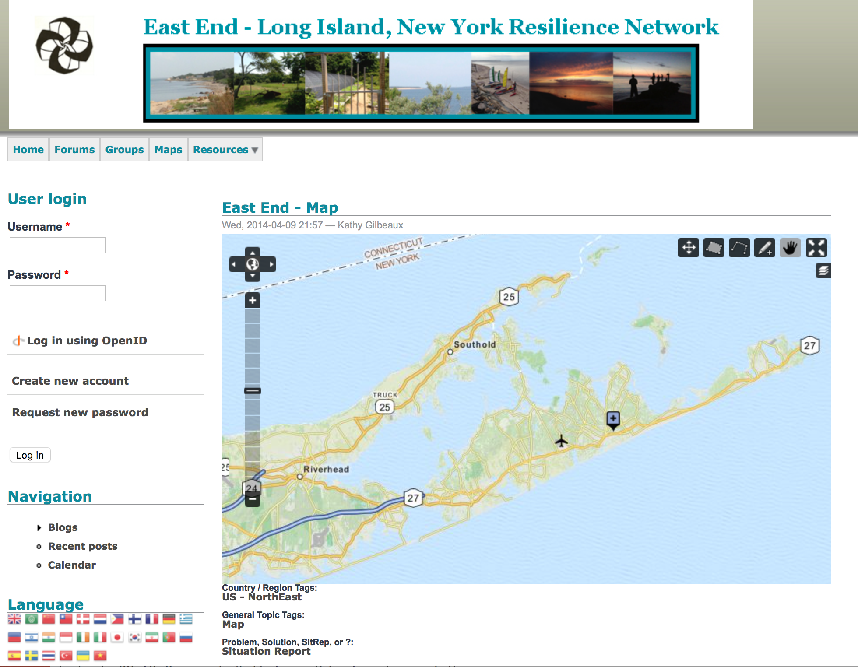
Achieving Energy Security, Health, Human Security and Sustainability on the South Fork in Uncertain Times

Slide 3
Preparing the East End for Resilience in the 2020 to 2030 Timeframes
Superstorm Sandy (e.g., the Rockaways)
Massive Failures in Central Infrastructures
Electrical & Gas Failures Burned Down Neighborhoods
No Food, No Light, No Water, No Sanitation
Millions of NY Customers’ Energy Services Compromised
Climate Change, Larger and More Frequent Storms, Collapsing Petrochemical Political Economy
A Decentralized Internet of Renewable Energy is Now Essential and Feasible At Less Cost with Better Service

Slide 4
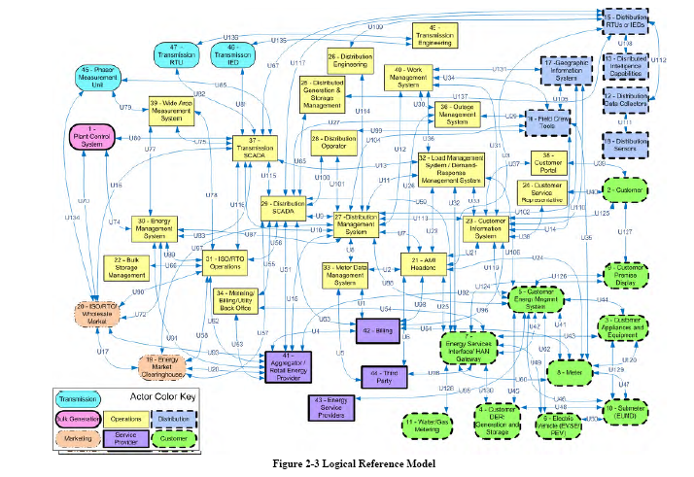
Emerging Grid is Highly Complex

Slide 5
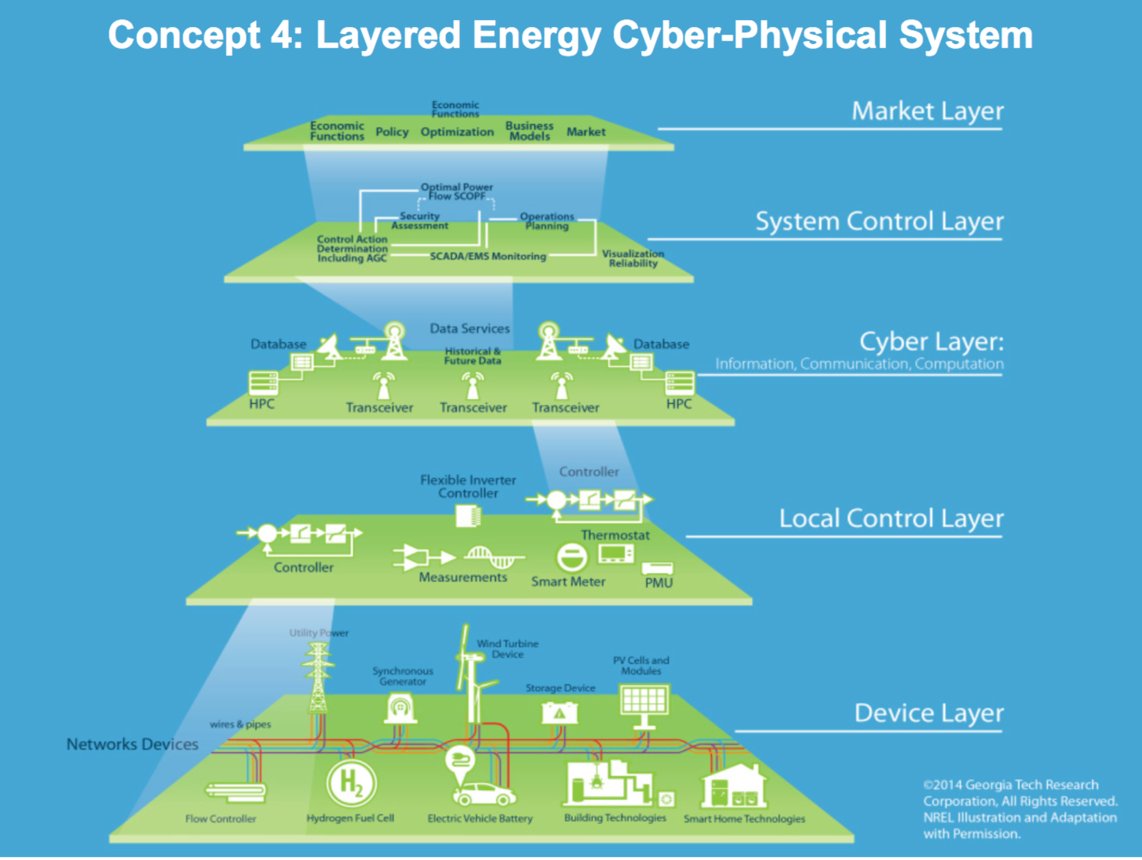

Slide 6
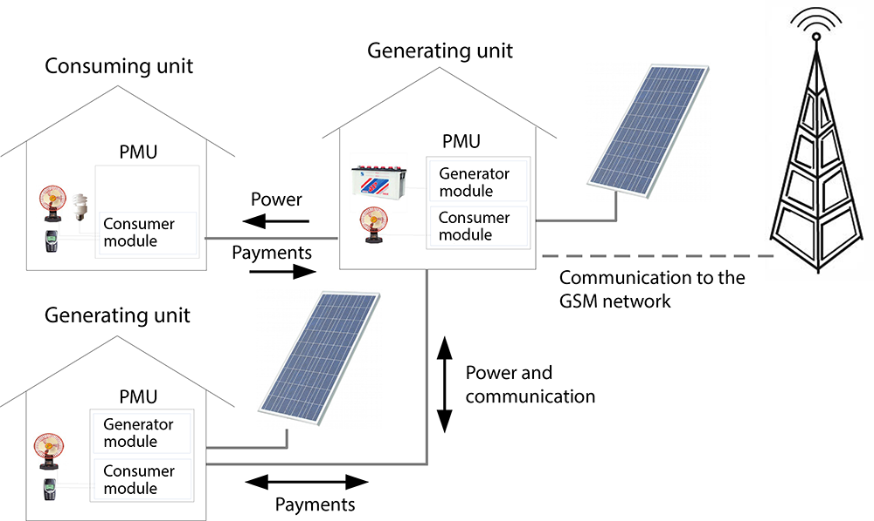
Distributed Collectively Intelligent Grid

Slide 7
Distributed Collectively Intelligent (DCI) Grid
Distributed: Not Dependent on the Centralized Hierarchical Grid, More Secure, Islandable, Less Costly, Better for Building Local Value Chains
Collectively Intelligent: Open Situational Awareness, Big Data, Graph Databases, Neural Net Structures, Architected as Complex Adaptive Systems
Grid: Nanogrids, Microgrids, Peer to Peer Connectivity, Linking Thru Prosumer Networks
Other Key Attributes: 100% Net Renewable Energy, Mesh Networks, Enhanced Battery Storage

Slide 8
DCI Grid Benefits
Eliminates Single Points of Failure
Scalable to Large Number of Control Points
Leverages Massive Scale-up of Mesh Network Communication and Computation

Slide 9
DCI Grid Benefits
Integrates Distributed Renewables
Leverages Distributed Collective Intelligence
Empowers and Incentivizes Prosumers
Enables Rapid Expansion of Sustainable Resilience Networks and Resilience Capacity Zones

Slide 10
DCI Grid Benefits
Increases Information Privacy
Enhances Cyber-security
Incrementally Deployable
Backward Compatible

Slide 11
DCI Grid Benefits
Provides Fail-safe Systems in Emergent Conditions
Leverage Internet of Things Sensing Investment
Leverages DOE ARPAe Investments

Slide 12
East End Resilience Network with a DCI Grid
Open Situational Awareness
Over All Mission Critical Functions in the South Fork Townships and Hamlets in Real Time
Citizens Understand Status of Their Community’s Mission Critical Functions
Red Zones (extremely vulnerable)
Yellow Zones (vulnerable)
Green Zones (Resilient)
Citizens Play an Expanded Role
Starting with Demand Response
Extending to Citizen and Community Management of All Local Mission Critical Functions
Growth in Green Value Chains
Improving Local Economy
Improving Local Employment

Slide 13
Why Discuss This with the South Fork Communities Now?
Petrochemical Political Economy is Beginning to Collapse
New Distributed Renewables and Microgrids are Growing Rapidly
Not Controllable Within the Current Centralized Energy Transmission System
REV and PSEG RFP Create a Catalyst for Significant Investment in South Fork DCI Grid
Collective Intelligence Growing In Resilience Systems with Significant Benefits
East End is in a Desirable Position
to Become a DCI Grid Test Bed
with Substantial Local Economic and Employment Advantages
DOE and Private Sector Resources Becoming Available for Testbeds

Slide 14
Next Steps in the South Fork DCI Grid Development
Identify Gaps and Solution Sets for the East End Energy Grid
Anticipatory Capacity through Serious Game Exercises
Community Designed, Community Led DCI Grid Plans For All Interested East End Townships, Hamlets, and Households
Simultaneously Build a South Fork Energy Grid Simulation
with Injects into the Community-based Serious Game Exercises
Develop a DCI Grid Platform Integrating All Renewables and Microgrid Projects Under Citizen and Community Control

Slide 15
East End Green Energy Resilience Initiative
Phase I Introduce 100% Net Renewable Energy Policies
Community-determined Gaps and Requirements
Simulation of Scenarios for Emerging Internet of Energy Options and Consequences of Different Scenarios
Testbed Attracting Investment, Innovation & Employment
Phase II Scale Up Solar, Wind, & Microgrid Installations
Phase III Distributed Controllers and Mesh Network Installations for South Fork Prosumer Networks
Phase IV Distributed Collectively Intelligent Grids

Slide 16
Distributed Collectively Intelligent (DCI) Grid To Increase Resilience on the South Fork
Michael.D.McDonald@mac.com
East End Resilience Network
http://eastend.newyork.resiliencesystem.org/
South Fork Clean Energy Forum
June 15, 2016

